Slide 1
Mobile Price Classification Using Machine Learning
This presentation aims to explore the application of machine learning techniques in the domain of mobile price classification. By leveraging machine learning algorithms, we can automate the process of categorizing mobile phones into distinct price ranges based on their specifications and features.

Slide 2
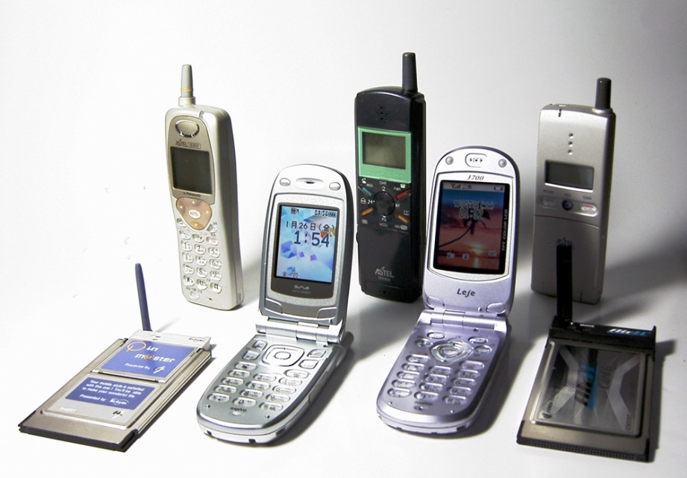
Problem Statement
The task is to build a predictive model that can accurately classify mobile phones into predefined price ranges based on various attributes such as battery power, camera features, memory, connectivity options, and more. The dataset provided contains information about several mobile phones, including their specifications and corresponding price ranges.

Slide 3



Introduction to Libraries and Models
I am using libraries such as pandas and numpy for data manipulation and preprocessing, matplotlib and seaborn for data visualization, and machine learning models like K-Nearest Neighbors (K-NN) for classification tasks. These tools enable us to efficiently analyze the dataset and build predictive models.

Slide 4
Dataset Details
The dataset comprises a comprehensive set of attributes for various mobile phones, including battery power, camera features, memory, and connectivity options. Each column in the dataset represents a specific attribute, while the rows correspond to individual mobile phone entries. Understanding the structure and content of the dataset is crucial for performing meaningful analysis and building accurate models.

Slide 5
battery_power: Total energy a battery can store in mAh.
blue: Bluetooth enabled (1 if yes, 0 if no).
clock_speed: Speed at which microprocessor executes instructions.
dual_sim: Dual SIM support (1 if yes, 0 if no).
fc: Front Camera mega pixels.
four_g: 4G network support (1 if yes, 0 if no).
int_memory: Internal Memory (in gigabytes).
m_dep: Mobile Depth in cm.
mobile_wt: Weight of mobile phone.
n_cores: Number of cores of the processor.
pc: Primary Camera mega pixels.
px_height: Pixel Resolution Height.
px_width: Pixel Resolution Width.
ram: Random Access Memory in megabytes.
sc_h: Screen Height of mobile in cm.
sc_w: Screen Width of mobile in cm.
talk_time: Longest time that a single battery charge will last when you are talking.
three_g: 3G network support (1 if yes, 0 if no).
touch_screen: Touch screen support (1 if yes, 0 if no).
wifi: Wifi connectivity (1 if yes, 0 if no).
price_range: Price range of the mobile phone (0 - low cost, 1 - medium cost, 2 - high cost, 3 -
very high cost).

Slide 6
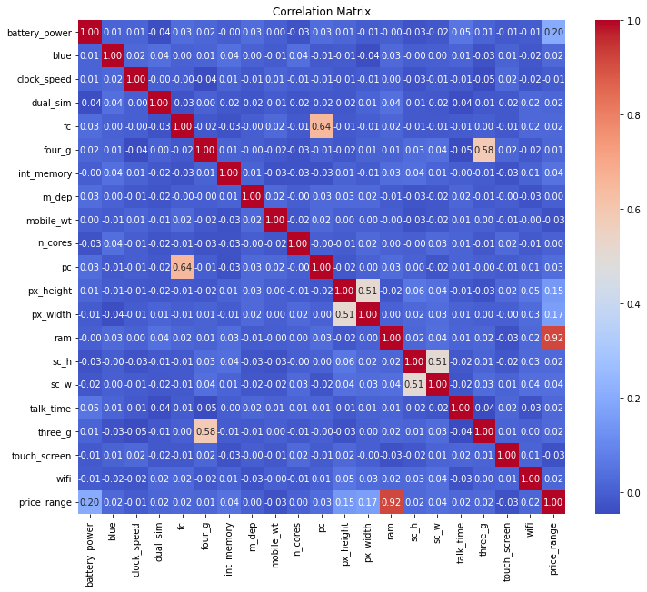
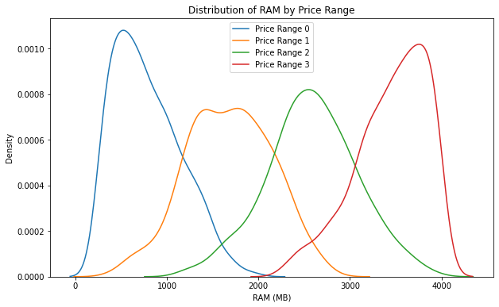
Exploratory Data Analysis (EDA)
In this segment of exploratory data analysis (EDA) phase, where I had visually explored the relationships between different features and the price range of mobile phones. Through visualizations such as correlation matrices, scatter plots, and histograms, we aim to identify patterns and insights within the data that may inform our modeling approach.

Slide 7
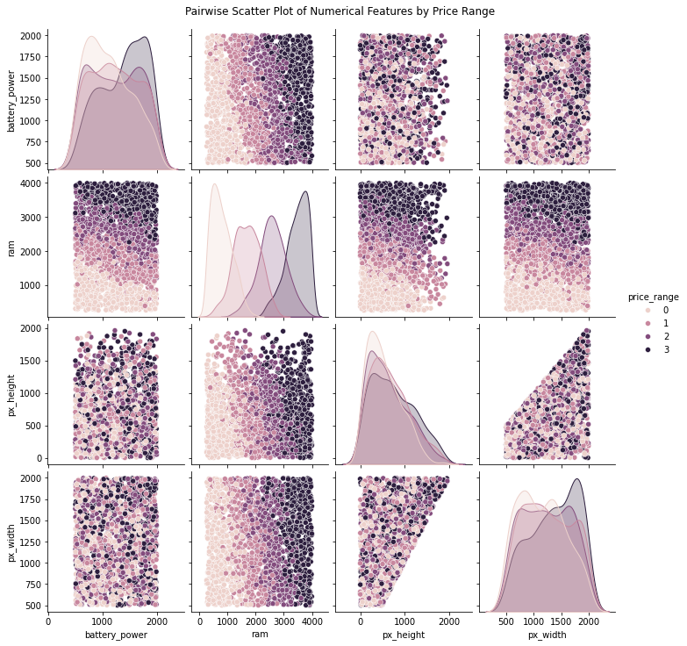
Further investigating the dataset using advanced visualizations such as pair plots and KDE (Kernel Density Estimation) plots. These visualizations allow us to uncover more relationships between features and gain a deeper understanding of the dataset's distribution and characteristics.

Slide 8
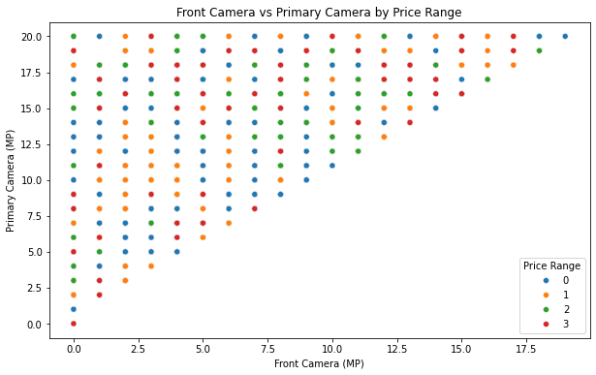
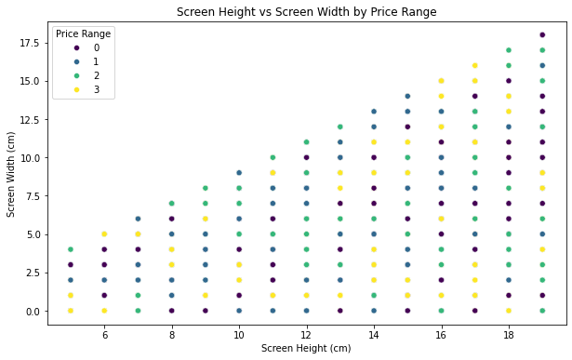

Slide 9
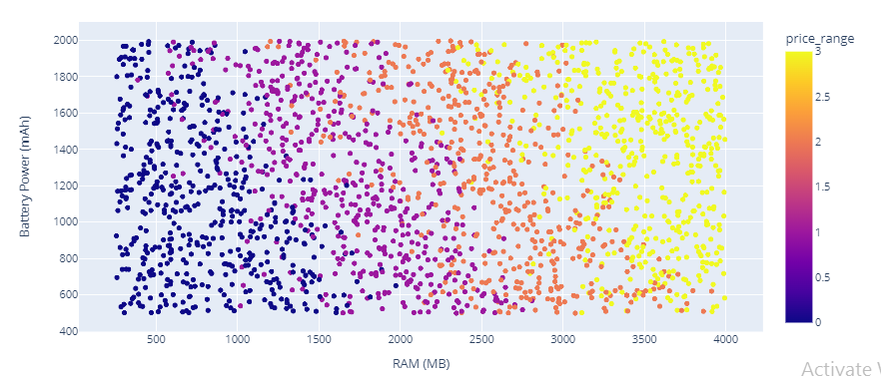

Slide 10
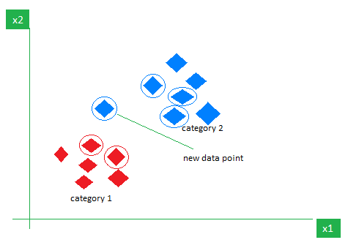
Model and Evaluation
For the model I had selected KNN model. KNN is one of the most basic yet essential classification algorithms in machine learning. It belongs to the supervised learning domain and finds intense application in pattern recognition, data mining, and intrusion detection.

Slide 11
Step-by-Step explanation of how KNN works
Step 1: Selecting the optimal value of K
K represents the number of nearest neighbors that needs to be considered while making prediction.
Step 2: Calculating distance
To measure the similarity between target and training data points, Euclidean distance is used. Distance is calculated between each of the data points in the dataset and target point.
Step 3: Finding Nearest Neighbors
The k data points with the smallest distances to the target point are the nearest neighbors.
Step 4: Voting for Classification or Taking Average for Regression
In the classification problem, the class labels of are determined by performing majority voting. The class with the most occurrences among the neighbors becomes the predicted class for the target data point.
In the regression problem, the class label is calculated by taking average of the target values of K nearest neighbors. The calculated average value becomes the predicted output for the target data point.

Slide 12
Advantages of the KNN Algorithm
Easy to implement as the complexity of the algorithm is not that high.
Adapts Easily – As per the working of the KNN algorithm it stores all the data in memory storage and hence whenever a new example or data point is added then the algorithm adjusts itself as per that new example and has its contribution to the future predictions as well.
Few Hyperparameters – The only parameters which are required in the training of a KNN algorithm are the value of k and the choice of the distance metric which we would like to choose from our evaluation metric.

Slide 13
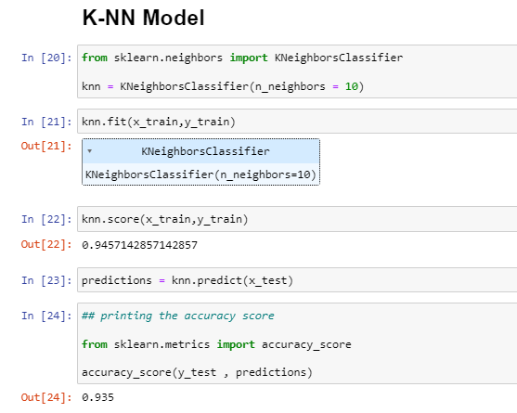

Slide 14
Conclusion
By successfully developing an accurate classification model, this project aims to empower consumers with
a tool that can assist them in making informed decisions while purchasing mobile phones within their
budget constraints. Additionally, the insights gained from this project could be valuable for manufacturers
and retailers in understanding consumer preferences and market trends.

Slide 15
References
https://www.kaggle.com
https://www.geeksforgeeks.org
https://scikit-learn.org
https://www.javatpoint.com/k-nearest-neighbor-algorithm-for-machine-learning

